Slide 1

Lake County safety council
Todd Ungar
Fire Chief
Willoughby fire department

Slide 2
first responder credentials
All have a minimum of Firefighter and EMT certifications – most are paramedic-level.
Some have these additional qualifications:
  Hazardous Materials Technician
  Technical Rescue: high angle, confined space, heavy equipment extrication
  Fire Inspector
  Fire Investigator
  Fire and EMS Instructor
  UAS / Drone FAA-licensed pilot

Slide 3
Topics of discussion
Facilities, Assets, and Equipment
Taking Care of Your People
Emergency Preparedness

Slide 4
Facilities, Assets, and equipment -
Things we’d like to know:
Gaining access to your facility when you’re not there.
Who are your experts that know your business and it’s processes?
How can we get a hold of you or a representative?
What are the items of value that require attention in a fire or disaster?

Slide 5
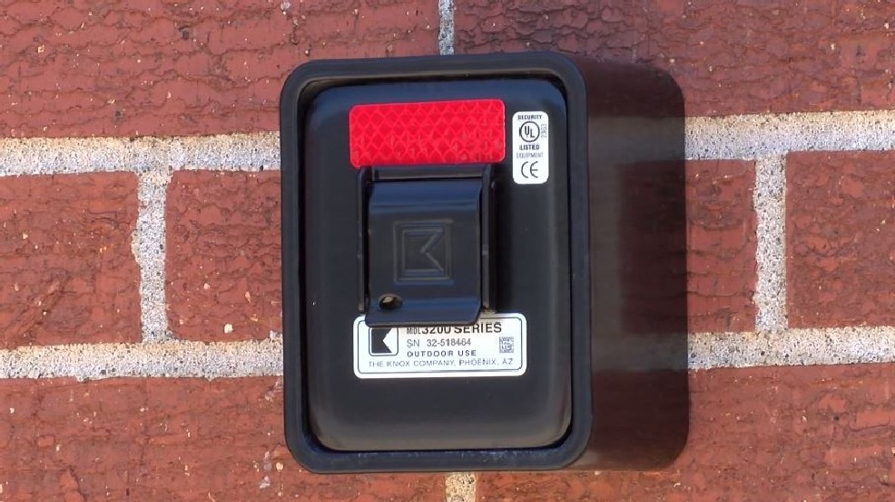

Slide 6
Gaining access
Knox Box
Your city fire department is the only agency with keys to access this box.
Keys, swipe cards, and contact information can be stored here.
Must be updated as keys and information change.

Slide 7
business sheet facts and tips
Must be updated to remain accurate.
Be mindful that this is most often used when you or your staff is not there – night times, weekends, holidays, etc.
Some businesses use a remote answering service to handle calls – for emergency purposes, we would prefer a direct-dial number to expedite the situation. Would you agree?

Slide 10
Things that we look for during medical emergencies
Employees
Medical information
What would you want a paramedic, nurse, or doctor to know if you are unconscious?
Who would you want contacted in the event of an emergency?
Has any of this information been updated recently?

Slide 11
Medical information
Must ensure that PHI is respected – check with HR or legal department.
The more information, the better care we can provide.
Must be updated to remain accurate.
We transport to a variety of hospitals, but we can’t always go to the location requested by the patient. Why?

Slide 12
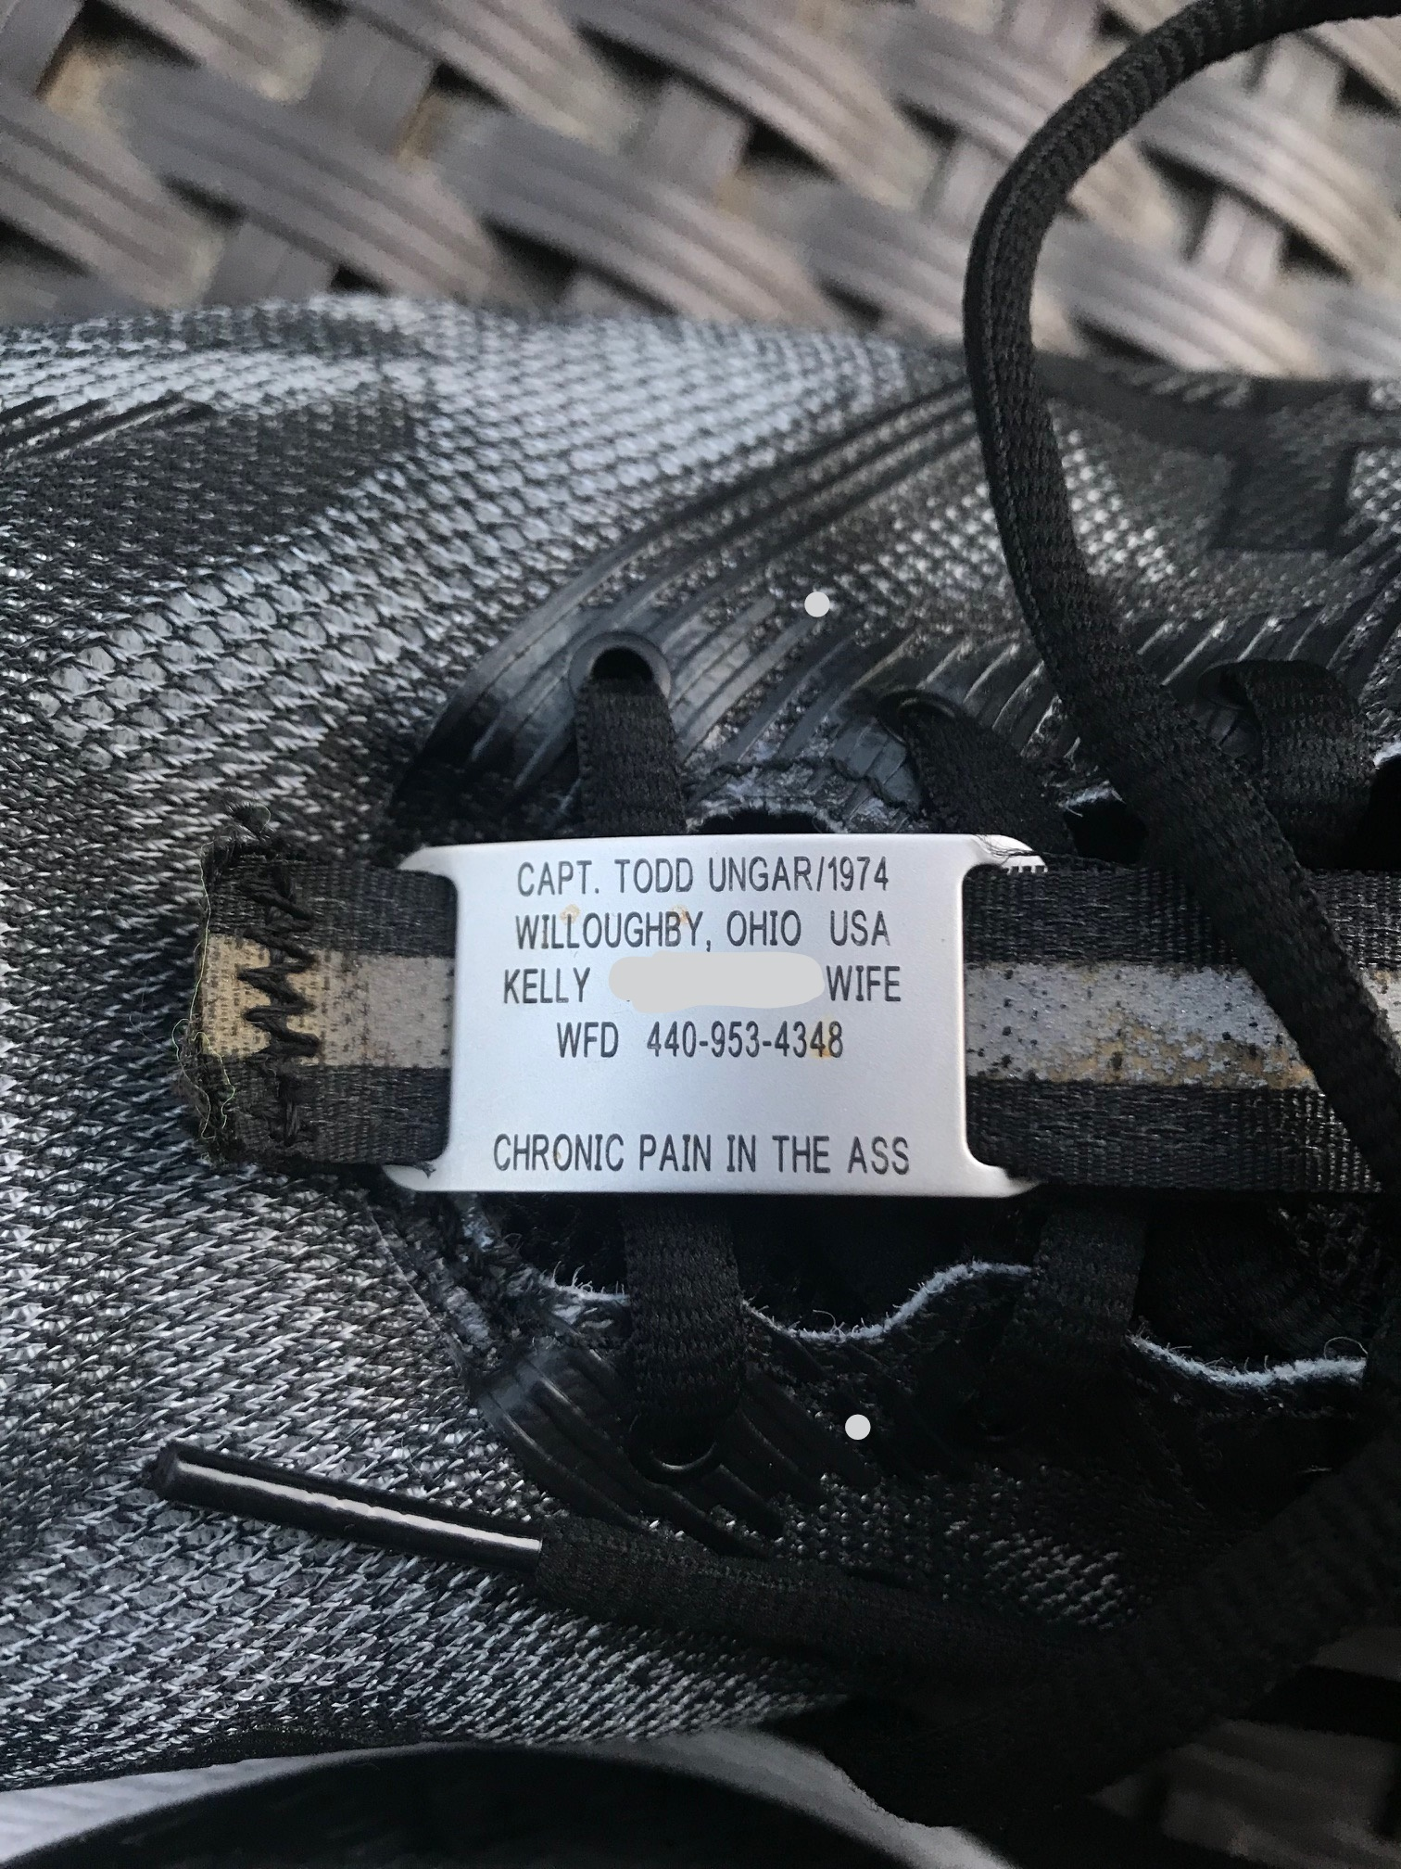
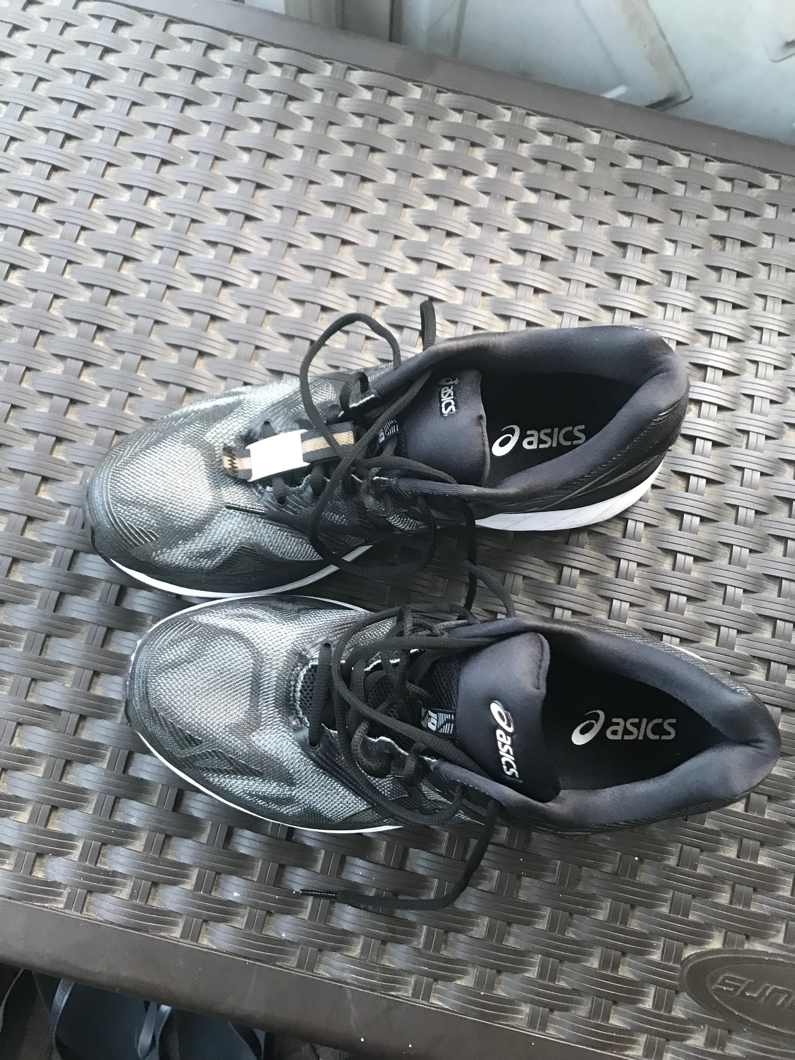

Slide 13
Emergency preparedness
We can help you with these!
Fire and severe weather drills
Working under no or limited power conditions
CPR
Fire extinguisher training
Workplace violence

Slide 14
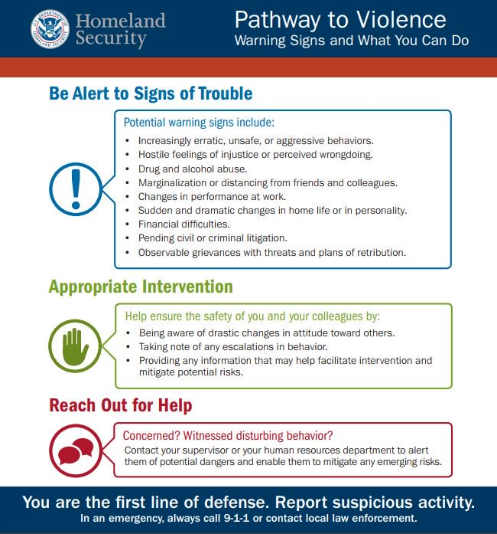

Slide 15


Slide 16

Questions?

